Slide 1
Xtract analysis

Slide 2
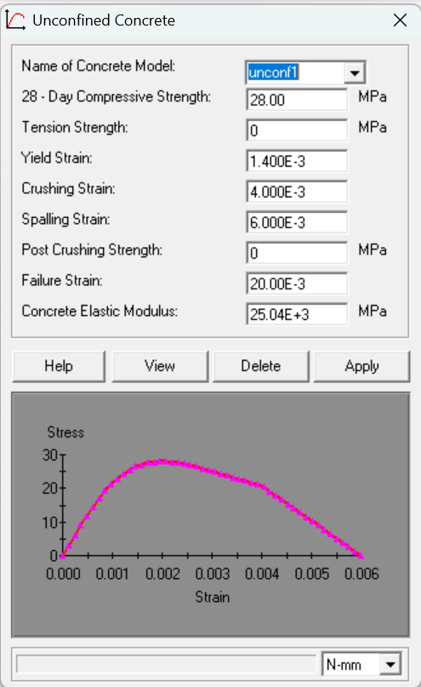
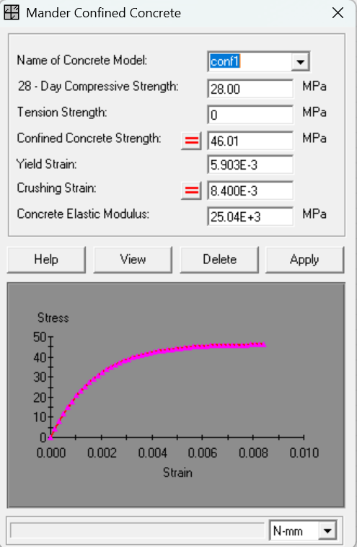

XTRACT ANALYSIS

Slide 3
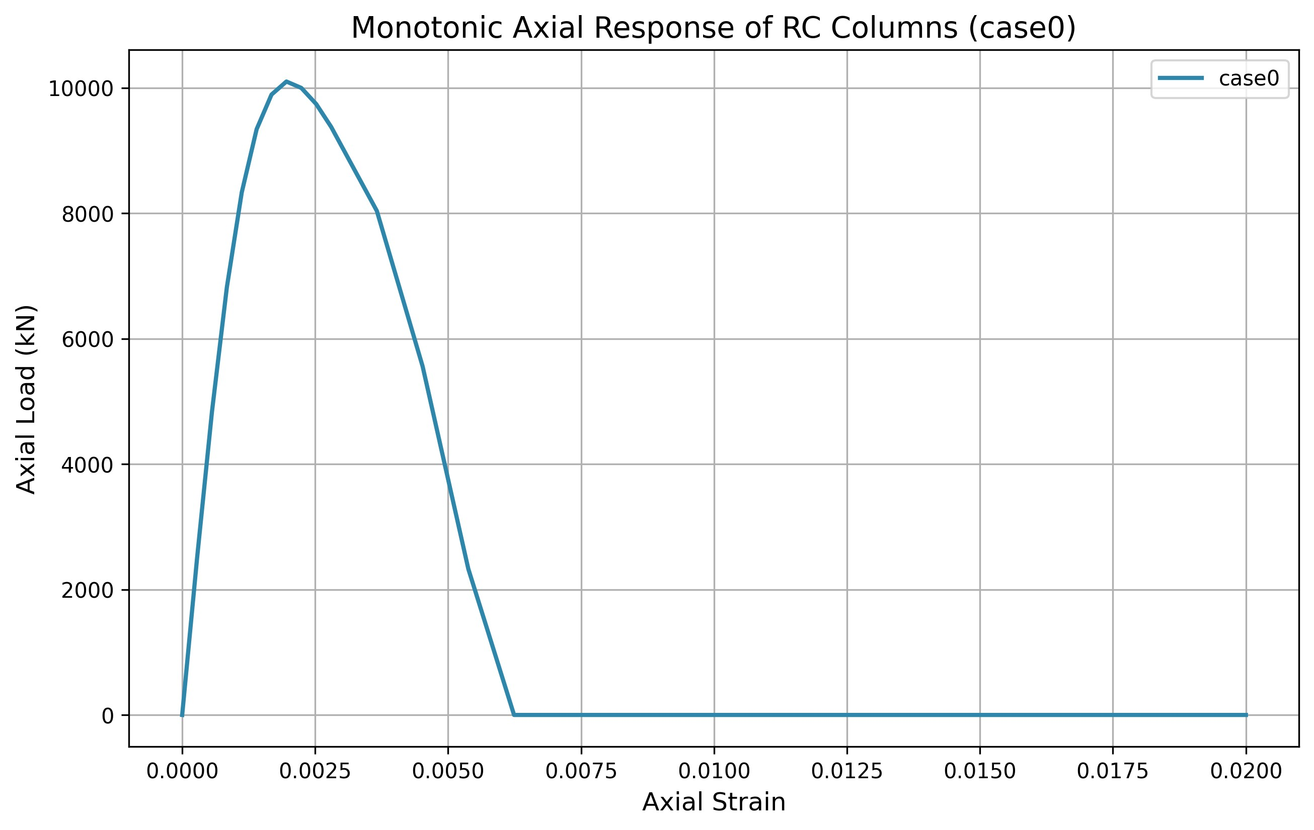
Unconfined 28 MPa
Peak load at 10000kN
After peak > sudden drop
Very low ductility

Slide 4
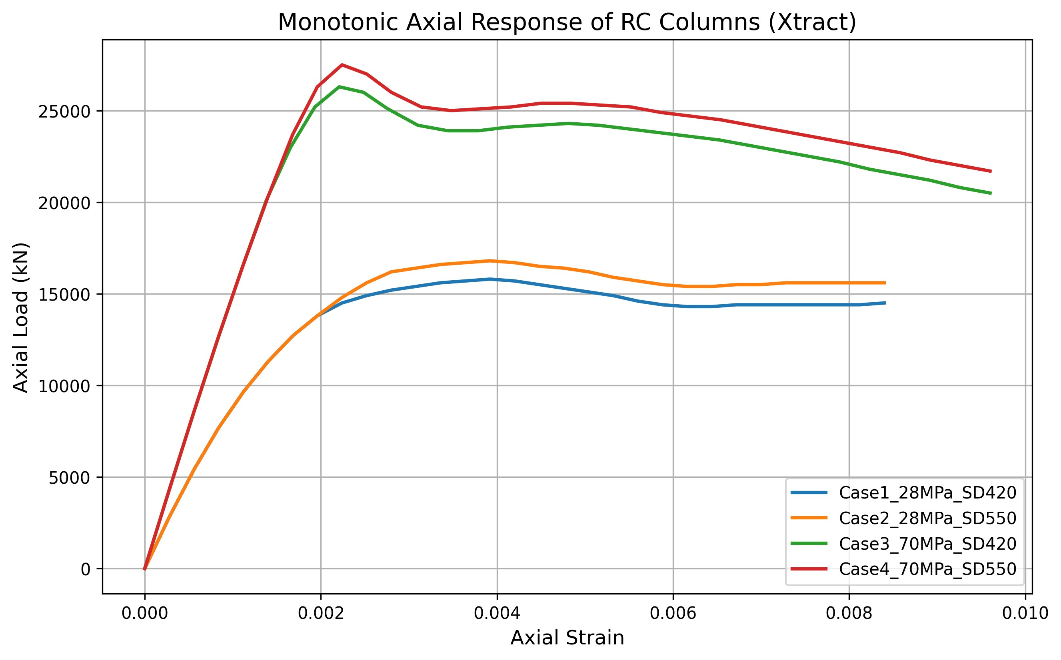
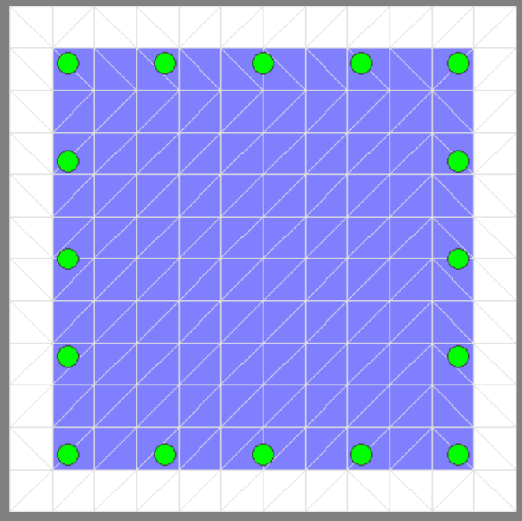
Confined Concrete Analysis
Stage3
Stage1
Stage 2
Stage3
Stage 2
Stage 1 Initial Elastic Response
Stage 2 Peak Load (ultimate strength)
Stage 3 Post Peak Behavior (softening / ductility)

Slide 5
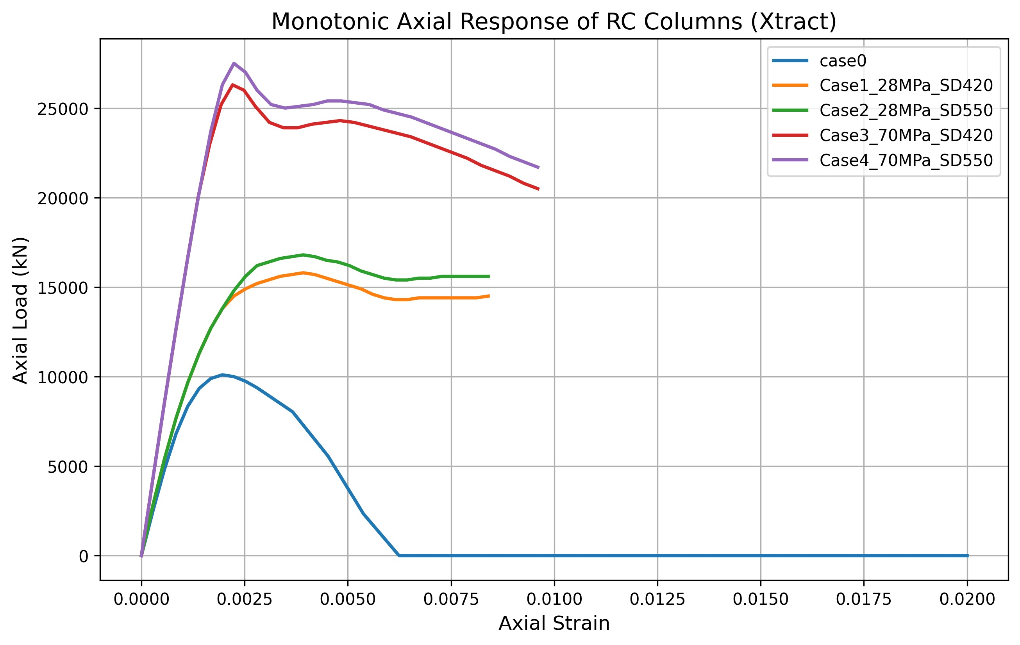
Confined Concrete Analysis
Much higher strength
Slightly steeper drop after peak
Lower strength
More gradual behavior
Sudden failure

